Slide 1
Lecture 03
Syntax Analysis 3-1

Slide 2
Where We Are
Lexical Analysis
Syntax Analysis
Semantic Analysis
IR Generation
IR Optimization
Code Generation
Optimization
Source
Code
Machine
Code

Slide 3
What is Syntax Analysis?
After lexical analysis (scanning), we have a series of tokens.
In syntax analysis (or parsing), we want to
Recover the structure described by that series of tokens.
Report errors if those tokens do not properly encode a structure.

Slide 4
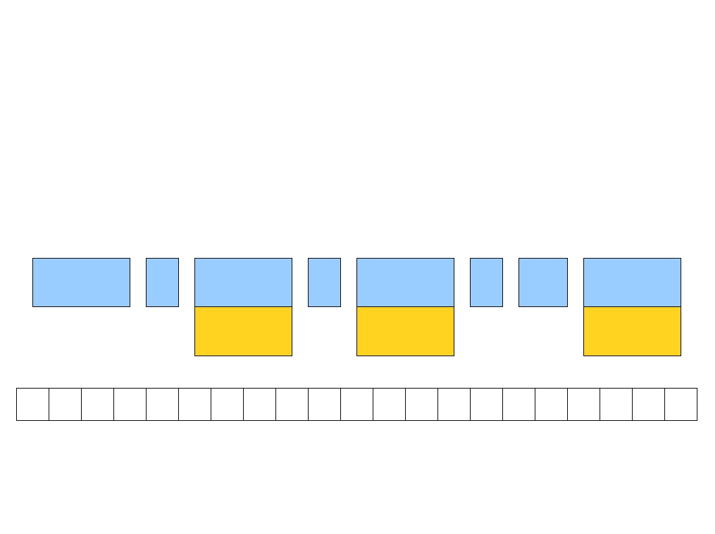
T_While
(
T_Ident
<
T_Ident
)
++
T_Ident
ip
z
ip
w h i l e
( i p
<
z ) \n\t + + i p ;
while (ip < z)
++ip;

Slide 5
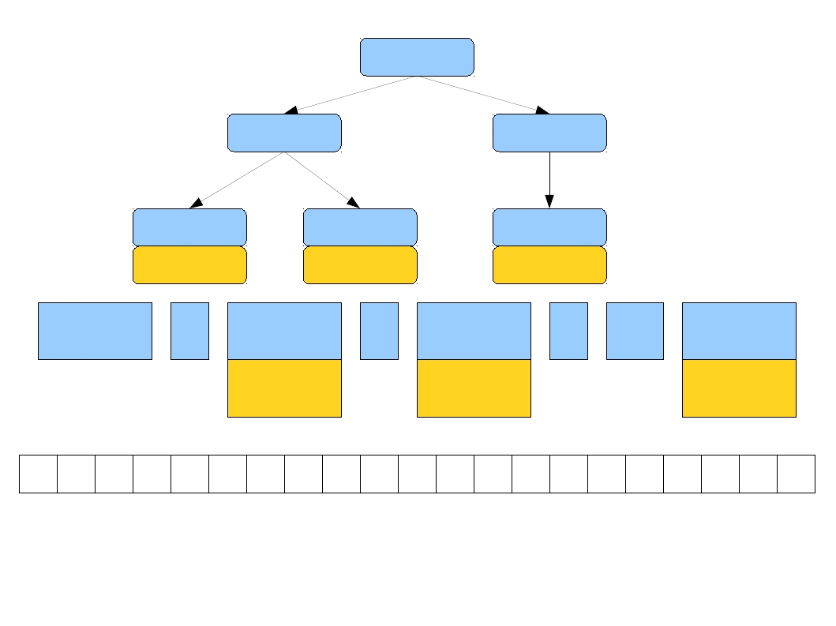
While
<
++
Ident
ip
Ident
z
Ident
ip
T_While
(
T_Ident
<
T_Ident
)
++
T_Ident
ip
z
ip
w h i l e
( i p
<
z ) \n\t + + i p ;
while (ip < z)
++ip;

Slide 6
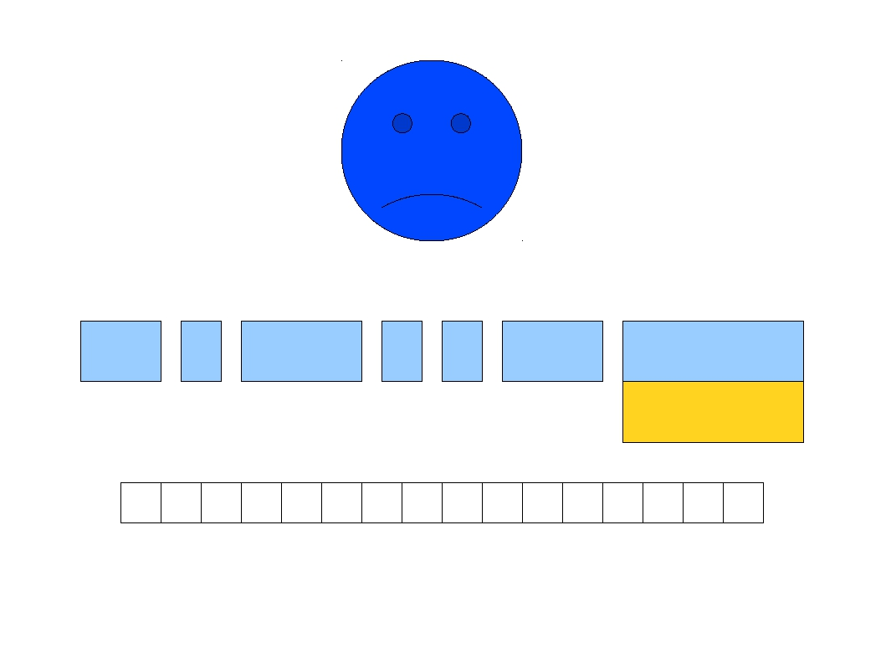
T_Do
[
T_For
]
=
T_New
T_IntConst
0
d o [ f o r ]
=
n e w
0 ;
do[for] = new 0;

Slide 7
What is Syntax Analysis?
Input: The parser calls a scanner procedure to fetch the next token
Output: An explicit or implicit syntax tree needs to be constructed.
getNextToken
scanner
parser
Parse tree
currentToken
Symbol Table

Slide 8
Outline
Formalisms for syntax analysis
Context-Free Grammars (this lecture)
CFG and Grammars
Derivations
Concrete and Abstract Syntax Trees
Ambiguity
Parsing algorithms
Top-Down Parsing
Bottom-Up Parsing

Slide 9
Formal Languages
An alphabet is a set Σ of symbols that act as letters.
A language over Σ is a set of strings made from symbols in Σ.
When scanning, our alphabet was ASCII characters. We produced tokens.
When parsing, our alphabet is the set of tokens produced by the scanner.

Slide 10
The Limits of Regular Languages
∑={a, b},
The set of strings S over this alphabet consisting of a single b surrounded by the same number of a.
S = {b , aba, aabaa, aaabaaa, …} ={a^{n}ba^{n}|n>=0,n ∈Z}
the regular expression is?
X
a*ba*
This set cannot be described by a regular expression.

Slide 11
The Limits of Regular Languages
When scanning, we used regular expressions to define each token.
Unfortunately, regular expressions are (usually) too weak to define programming languages.
Cannot define a regular expression matching all expressions with properly balanced parentheses.
Cannot define a regular expression matching all functions with properly nested block structure.
We need a more powerful formalism.

Slide 12
Context-Free Grammars
A context-free grammar (or CFG) is a specification for the syntactic structure of a programming language
Similar to regular expressions except that a context-free grammar involves recursive rules.
a strict superset of the regular languages.

Slide 13
Context-Free Grammars
Example
context-free grammar for integer arithmetic expression
exp → exp op exp | (exp) | num
op → + | - | * | /
regular expression for number
num = digit digit*
digit = 0|1|2|3|4|5|6|7|8|9

Slide 14
Context-Free Grammars
Definition
A context-free grammar G= (V_{T},V_{N}, P, S):
V_{T} is a set of terminals.
V_{N} is a set of nonterminals, V_{N}∩V_{T}=φ.
P is a set of productions, or grammar rules, of the form A→ α,where A∈ V_{N} and α∈ (V_{N}∪V_{T}) *.
S is a start symbol , S∈V_{N}

Slide 15
Context-Free Grammars
V_{T} are the basic symbols from which strings are formed. Terminals are tokens
V_{N} are names for structures that denote sets of strings
The set of strings that start symbol “S” denotes is the language defined by the grammar
A production defines a structure whose name is to the left of the arrow. The layout of the structure is defined by the right of the arrow

Slide 16
Context-Free Grammars
“→” shows the left of the arrow cannot simply be replaced by its definition, as a result of the recursive nature of the definition
X → Y₁ ... Y_{n} Means X can be replaced by Y₁ ... Y_{n}
X → ε Means X can be replaced with empty string
The form of productions(A→ α) is called Backus-Naur form(or BNF)

Slide 17
Example
The grammar of simple arithmetic expression G= (V_{T},V_{N},P,S):
V_{T}={num, +, -, *, /, (, ) }
V_{N}={exp, op}
exp is the start symbol
productions are:
exp → exp op exp
exp → (exp)
exp → num
op →+
op → -
op → *
op → /

Slide 18
Notation Conventions
With the following conventions, we can only write productions of a grammar
Unless otherwise stated, the left side of the first production is the start symbol
Using lower-case letters to represent terminals
Using upper-case letters or name with <…> to represent nonterminals
If A→α₁,A→α₂,…,A→α_{n} are all productions with A on the left, we may write A→α₁|α₂|…|α_{n}

Slide 19
Not Notational Shorthand
The syntax for regular expressions does not carry over to CFGs.
Cannot use *, |, or parentheses.
X
S → a*b
S → Ab
A → Aa | ε

Slide 20
Not Notational Shorthand
The syntax for regular expressions does not carry over to CFGs.
Cannot use *, |, or parentheses.
X
S → a(b|c*)
S → aX
X
X → (b|c*)

Slide 21
Not Notational Shorthand
The syntax for regular expressions does not carry over to CFGs.
Cannot use *, |, or parentheses.
X
S → a(b|c*)
S → aX
X
X → b|c*

Slide 22
Not Notational Shorthand
The syntax for regular expressions does not carry over to CFGs.
Cannot use *, |, or parentheses.
X
S → a(b|c*)
S → aX
X → b|C
C → Cc | ε

Slide 23
Chomsky hierarchy of grammar
23
There are four kinds of grammars:
Unrestricted grammar (type 0)
Context sensitive grammar (type 1)
Context free grammar (type 2)
Regular grammar (type 3)
Notes:
23

Slide 24
Chomsky hierarchy of grammar
Chomsky hierarchy | Production | Explanation
unrestricted (type 0) | α→β V=V_{N}∪V_{T} α∈V⁺ , β∈V* | there is no restriction to production
context sensitive (type 1) | αAγ→αβγ, α,γ ∈ V* A∈V_{N} , β∈V* | A may be replaced only if α occurs before A and γ occurs after A
context free (type 2) | A→β，A∈V_{N} ， β∈V* | A may be replaced anywhere, regardless of where A occurs
regular (type 3) | A→aB or A→a， A,B∈V_{N} ，a∈V_{T} | equivalent to regular expression

Slide 25
Example
Context sensitive grammar
S → aSBE S → aBE eB → eE
aB → ab bB → bb bE → be eE → ee
Context free grammar
S→AB A→BS | 0 B→SA | 1
Regular grammar
S→0A|1B|0 A →1B|0 B→0

Slide 26
Chomsky hierarchy of grammar
unrestricted
context sensitive
context free
regular
26
The Relationship of these four grammars:
Notes:
26

